Slide 1
Serverless Image Processing
USING AWS
Services Used : S3, IAM, Lambda, and SNS

Slide 2
Introduction
Serverless computing has revolutionized the way we deploy and manage applications. This presentation documentation outlines the process of implementing a serverless image processing solution using Amazon Web Services (AWS). We will cover the manual method of utilizing AWS services such as S3, IAM, Lambda, and SNS to create a seamless image processing pipeline.

Slide 3
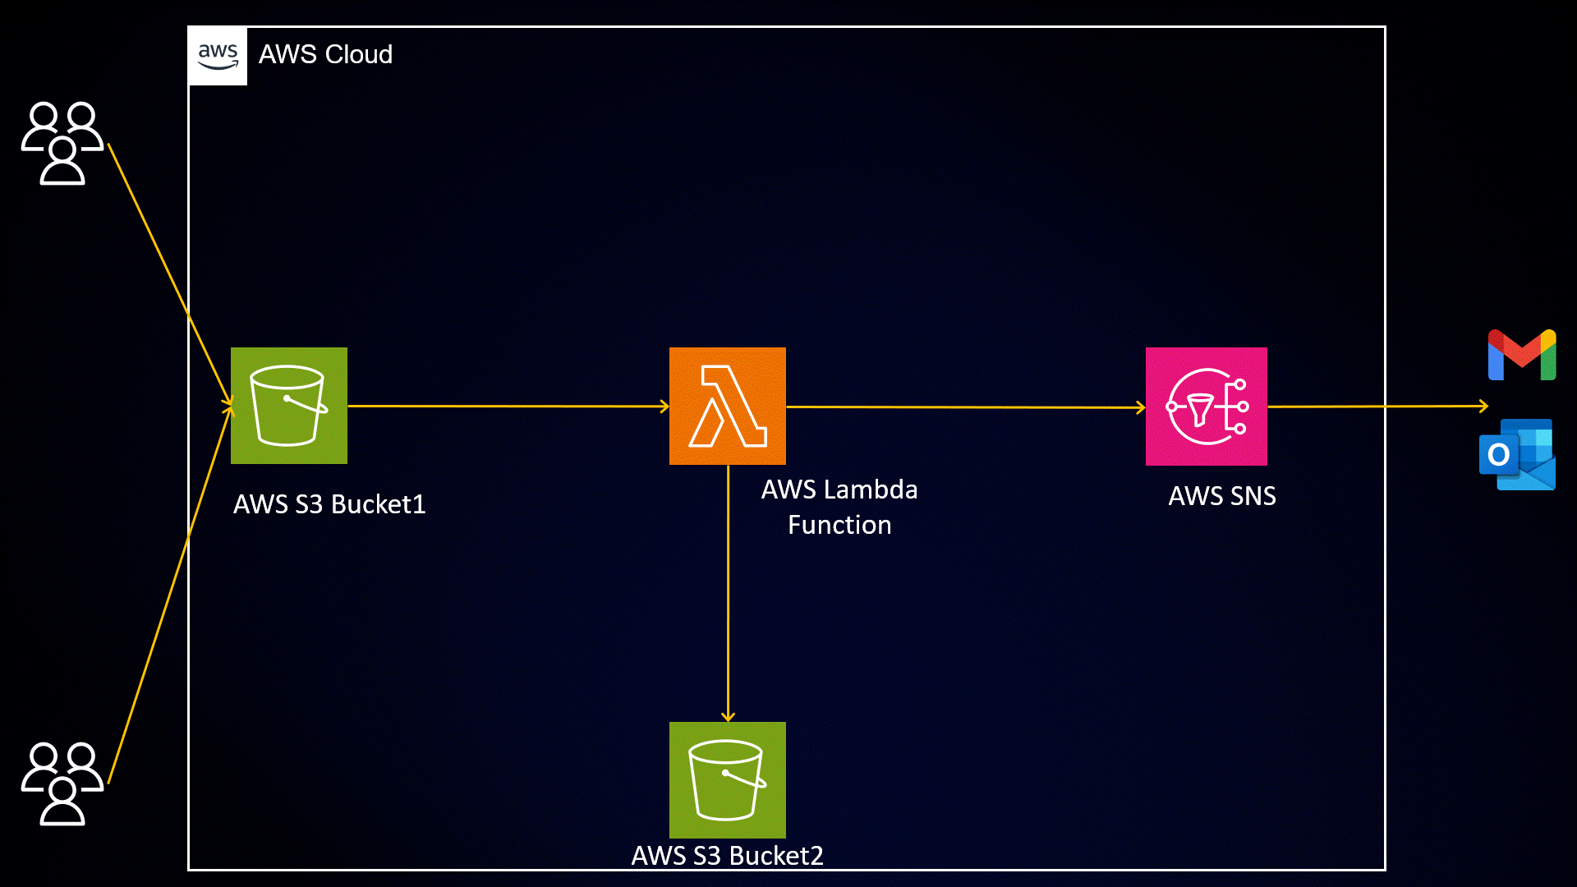
WHOA!
This could be the part of the presentation where you can introduce yourself, write your email...

Slide 4
01
02
Uploading Images to S3 Bucket
IAM Role Configuration
Begin by uploading images to an S3 bucket.
S3 (Simple Storage Service) provides scalable object storage.
Set appropriate bucket permissions.
Create an IAM (Identity and Access Management) role for Lambda.
Assign policies that grant permissions to access the S3 bucket and send SNS notifications
These permissions are essential for Lambda to interact with other services.

Slide 5
03
04
Lambda Function Setup
SNS Topic Creation
Create an IAM (Identity and Access Management) role for Lambda.
Assign policies that grant permissions to access the S3 bucket and send SNS notifications
These permissions are essential for Lambda to interact with other services.
Create a Lambda function using the chosen runtime
Configure the function to use the previously created IAM role.
Write the processing logic within the Lambda function
This could involve image resizing, format conversion, watermarking, etc.

Slide 6
05
06
Lambda-S3 Trigger Configuration
Image Processing Execution
Configure a trigger that links the Lambda function to the S3 bucket.
Specify the event types (e.g., object creation) that trigger the Lambda function.
When an image is uploaded to the S3 bucket, the Lambda function will automatically execute.
When an image is uploaded, the Lambda function is triggered.
The Lambda function retrieves the image from the S3 bucket.
Executes the processing logic on the image.
Stores the processed image back into the S3 bucket.
Once image processing is complete, the Lambda function publishes a message to the SNS topic
Subscribed clients or applications can receive these notifications

Slide 7
Benefits
Cost-Efficiency: Serverless architecture allows you to pay only for the compute time you consume, minimizing costs.
Scalability: AWS automatically scales resources as needed, ensuring smooth operation even during traffic spikes.
Simplicity: Serverless reduces infrastructure management, letting you focus on code and business logic.
Flexibility: The modular nature of serverless components makes it easy to adapt and extend the pipeline.

Slide 8

By leveraging AWS services like S3, IAM, Lambda, and SNS, you can create a powerful and automated serverless image processing pipeline. This approach not only simplifies the development process but also ensures efficient and cost-effective resource utilization

Slide 9
02
Deploy a Static Website on AWS

Slide 10
Introduction
we will go through the process of creating and deploying a static website using various AWS services. A static website is a site that consists of HTML, CSS, and JavaScript files and doesn't require server-side processing or a database. We will leverage AWS services to host, store, and deliver your static website efficiently.

Slide 11



Prerequisites
AWS account
Website files
S3 Service
An AWS account (https://aws.amazon.com/)
Website files (HTML, CSS, JavaScript, images, etc.)
Basic understanding of AWS services and web technologies

Slide 12

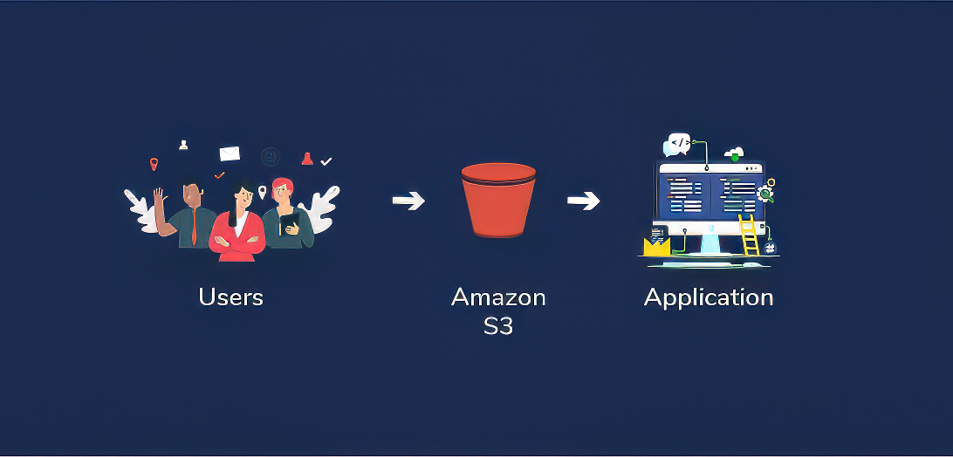
Step-by-Step Guide
Create an S3 Bucket
Upload Website Files
Configure Bucket for Static Website Hosting
Enable Public Access
Secure Your Bucket (Optional)
Testing Your Website

Slide 13
Thank you
Do you have any questions?
Reach me out
https://www.linkedin.com/in/nishant4you/

